Slide 1
Numerical Multi-table
Question Answering
Feng Luo, Hai Lan, Hui Luo, Zhifeng Bao, Xiaoli Wang, J. Shane Culpepper, Shazia Sadiq. Decomposition-Driven Multi-Table Retrieval and Reasoning for Numerical Question Answering.
ICDE 2026.
Notes:
This work serves as an example to demonstrate our approach to the multi-table retrieval problem.

Slide 2



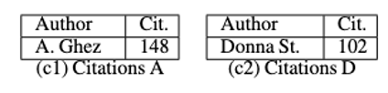
Numerical Multi-Table Question Answering
Why
Fragmentation of related data across multiple tables
Numerical question: What is the total citation count of female Nobel Physics laureates after 2010?
Answering it requires correctly identifying relevant values from tables a, b, c1, and c2.
Multiple tables containing the relevant data to the question

Slide 3
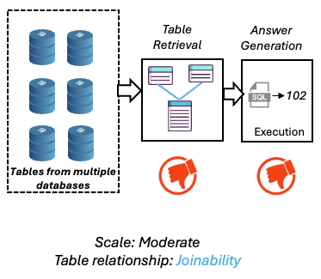
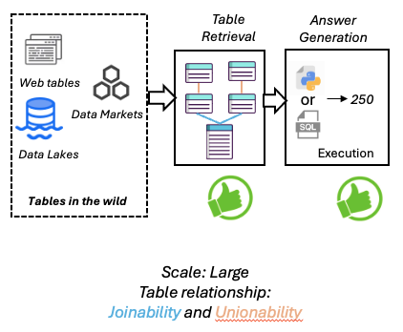
Numerical Multi-Table Question Answering
Why
The gap in existing work
Limited support for complex table relationships
With up to a 10% drop in table retrieval effectiveness when fail to model complex relationships
Ineffective retrieval of relevant tables at scale
With up to a 40% drop in retrieval effectiveness as the corpus scales from approximately 10² to 10⁵ tables.
Inaccurate answer generation over isolated tables
With up to a 20% drop in answer accuracy
Vs.
Existing work
Our targeted scenario

Slide 4




Numerical Multi-Table Question Answering
Goal
Input
Output
What is the total citation count of female
Nobel Physics laureates after 2010?
A numerical question
250
An answer
Tabular Data Lake
Objective
Effectively retrieve a subset of relevant tables for the question

Slide 5
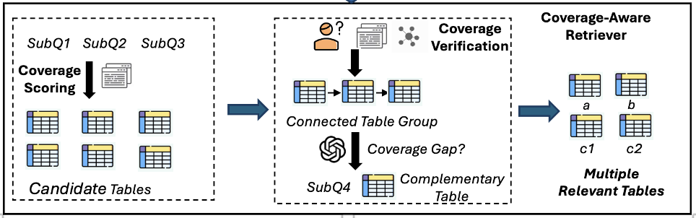
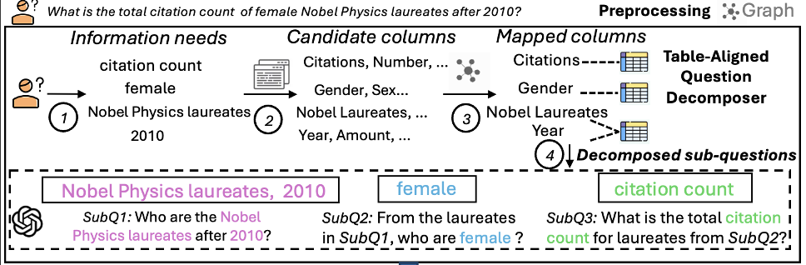
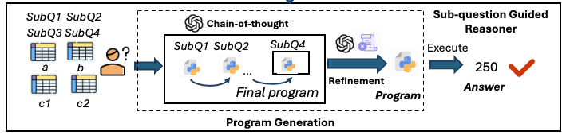
Numerical Multi-Table Question Answering
Challenge
Effectively retrieve relevant tables at scale considering complex table relationships
Our Approach
1. Preprocessing: construct a table relationship graph to capture complex table relationships
2. Table-Aligned question decomposer: decompose question into multiple sub-questions via structure-driven decomposition
3. Coverage-Aware retriever: retrieve relevant tables based on sub-questions by maximizing question coverage
4. Sub-question guided reasoner: produce correct answer by progressively generating and refining the reasoning program
How

Slide 6
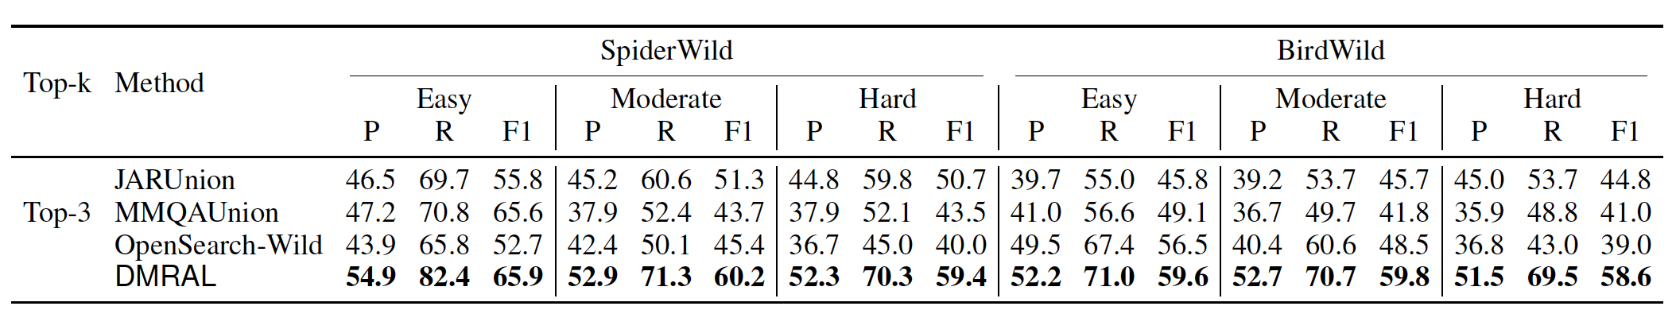
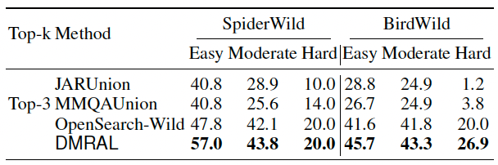
Numerical Multi-Table Question Answering
Exp
Main Experiment Results
Table retrieval effectiveness
Our method DMRAL achieves 24% improvement in multi-table retrieval.
Answering accuracy
Our method DMRAL achieves 55% improvement in answer accuracy.

Slide 7
Numerical Multi-Table Question Answering
Summary
Contribution
We propose DMRAL, a Decomposition-driven Multi-table Retrieval and Answering framework for MTQA over Large-scale table collections.

